Slide 1
REMOTE ACCESS
“By Slidesgo”

Slide 2
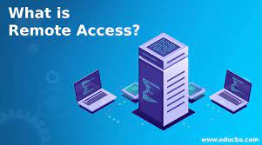
What is remote access?
Remote access is the ability for an authorized person to access a computer or network from a geographical distance through a network connection.
Remote access enables users to connect to the systems they need when they are physically far away. This is especially important for employees who work at branch offices, are traveling or telecommute.
Remote access enables remote users to access files and other system resources on any devices or servers that are connected to the network at any time. This increases employee productivity and enables employees to better collaborate with colleagues around the world.

Slide 3
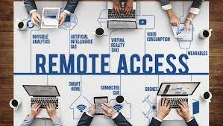
This connection allows users to access a network or computer remotely via the internet.
A remote access strategy gives organizations the flexibility to hire the best talent regardless of location and promote collaboration between teams, offices and locations.
Technical support professionals can use remote access to connect to users' computers from remote locations to help them resolve issues with their systems or software.

Slide 4
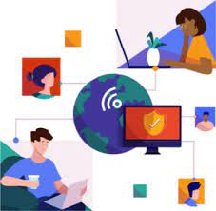
Examples
Examples of Remote Access
Allowing Employees At-Home Access To Work Devices.
Employers Assisting Remote Employees When Needed.
IT Specialists Troubleshooting Remote Devices.
Employees Collaborating Easily Independent of Location.
Remote Workers Accessing Their At-Home Computers from Portable Devices.

Slide 5
How does remote access work
Remote access is accomplished with a combination of software, hardware and network connectivity.
Software: Using a secure software solution like a VPN.
Hardware: By connecting hosts through a hard-wired network interface or Wi-Fi network interface.
Network: By connecting via the internet.
Remote access simply works by linking the remote user to the host computer over the internet.
Once the software is installed, the local computer can access the remote computer and perform several tasks like running applications, managing updates, and even handling administrative tasks

Slide 6
TYPES of remote access
Cable Broadband
Broadband
DSL (digital subscriber line)
Cellular internet service
Satellite
Fiber optics broadband

Slide 7
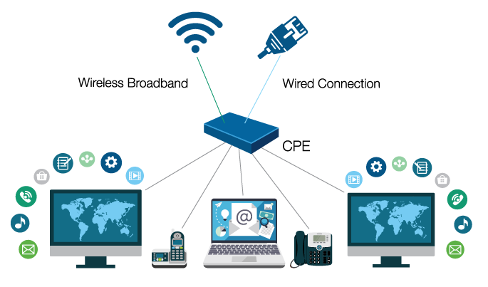
Broadband
Broadband provides remote users with high-speed connection options to business networks and to the internet.

Slide 8
Cable Broadband
Cable broadband shares the bandwidth with many users.
Cable broadband shares bandwidth across many users and, as a result, upstream data rates can be slow during high-usage hours in areas with many subscribers.

Slide 9
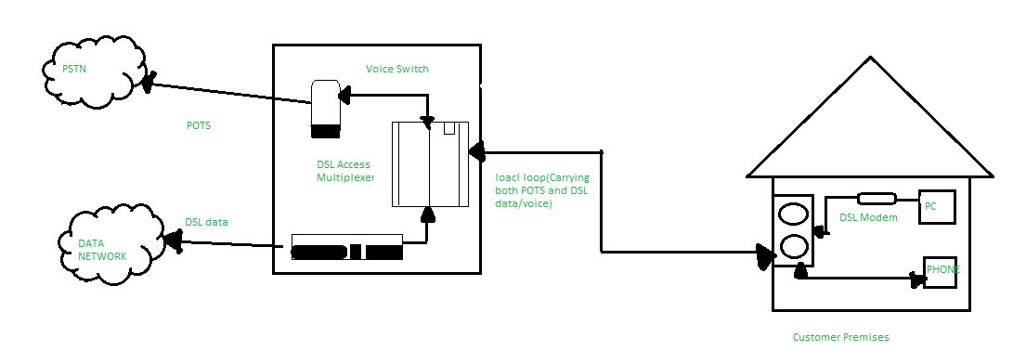
DSL (digital subscriber line)
DSL (digital subscriber line) uses a telephone network and is not always available if the infrastructure is poor.

Slide 10
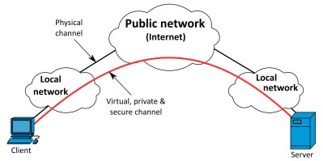
Cellular internet service
Cellular internet service uses mobile devices via a wireless connection; only possible if a cellular network is available.

Slide 11
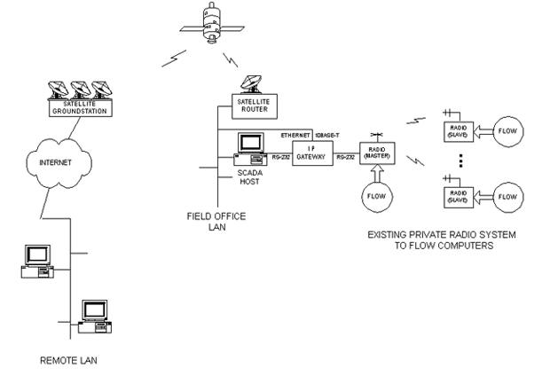
Satellite
Satellite uses satellites to provide internet access.

Slide 12
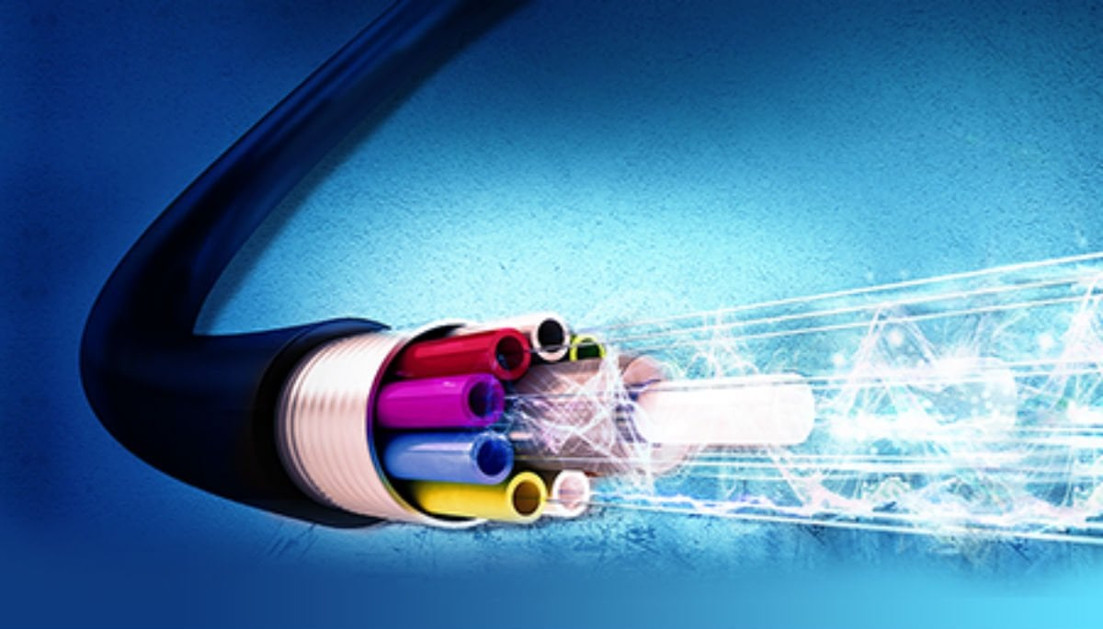
Fiber optics broadband
Fiber optics broadband one of the best ways to transfer massive amounts of data and do so quickly.

Slide 13
REMOTE ACCESS PROTOCOL
It is a communications standard that allows your computer to talk to the remote network.

Slide 14
TYPES OF REMOTE ACCESS PROTOCOLS
PPP (Point-to-Point Protocol)
IPsec (Internet Protocol Security)
PPTP (Point-to-Point Tunneling)
L2TP (Layer Two Tunneling Protocol)
Remote Authentication Dial-In User Service (RADIUS)

Slide 15
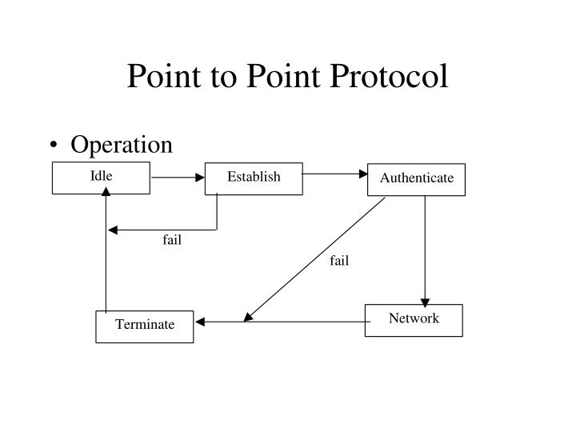
PPP (Point-to-Point Protocol)
Point-to-point protocol (PPP) enables hosts to set up a direct connection between two endpoints.
Error Control
Security through password protection methods.
Provides Speed and reliability.

Slide 16
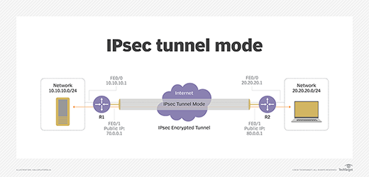
IPsec (Internet Protocol Security)
Ipsec (internet protocol security) enables authentication and encryption for IP packet transfers using several security protocols.

Slide 17
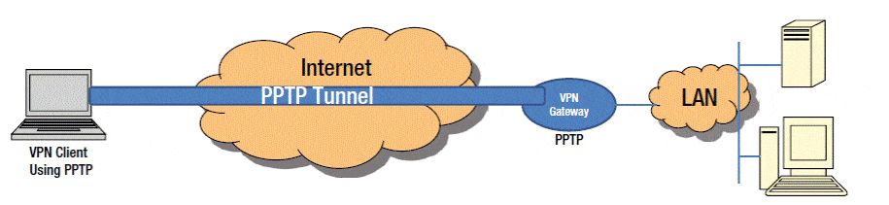
PPTP (Point-to-Point Tunneling)
Point-to-point tunneling (PPTP) is one of the oldest protocols for implementing virtual private networks.
Great option because it is simple and secure.
Created by Microsoft

Slide 18
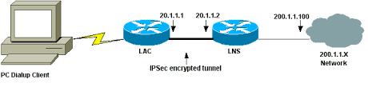
Layer Two Tunneling Protocol (L2TP)
It doesn’t offer encryption but depends on encryption protocol to provide privacy.

Slide 19
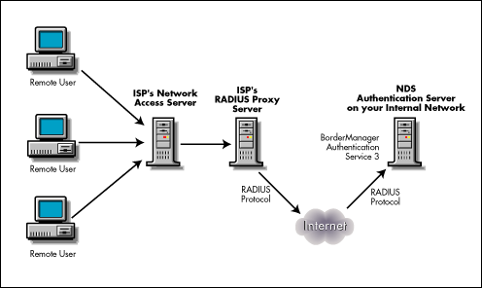
Remote Authentication Dial-In User Service (RADIUS)
Remote authentication dial-in user service (RADIUS) is a networking protocol that provides centralized authentication, authorization, and accounting (AAA) management for users who connect and use a network service.

Slide 20
Thank you!
“By Slidesgo”

